Slide 1



1. INTRODUCING INFORMATION AND
COMMUNICATION TECHNOLOGY
D. Serikbayev East Kazakhstan State Technical University
ICT Spring 2019
Notes:
Welcome to this series on an introduction to ICT. We will introduce ICT by looking at information and communication, then focus on ICT technologies. We also discuss ICT standards and their importance. We will examine using how ICTs are used in one sector of today's society, which is education. The primary goal of the series is to understand how ICT functions so you can see what role it plays in today’s society.

Slide 2

Copyright Notice
This presentation is presented as is. This presentation was assembled using information from various websites or sources across the web.
This presentation uses Creative Commons Attribution 4.0 International (CC BY 4.0). © 2019 BilimEdtech

Slide 3

1.1. Information and Communication
1.1. Information and Communication
1.2. Technology
1.3. ICT in Education
1.4 Standards
Notes:
The first section introduces ICTs, with a focus on information and communication.

Slide 4
Learning Objectives
Describe the role that ICT plays in today’s society
Understand the focus of ICT
Understand the first two parts of ICT, which are information and communication
Describe the difference between synchronous and asynchronous communication
Notes:
The primary goal of the series is to understand how ICT functions so you can see what role it plays in today’s society.

Slide 5
Information and Communications Technology
Information and Communications Technology (ICT) refers to technologies that provide access to information through telecommunications
It is similar to Information Technology (IT) but focuses primarily on communication technologies
Notes:
If you are not familiar with the term ICT, it stands for information and communications technology. ICT refers to technologies that provide access to information through telecommunications. ICT is similar to IT, but with a focus on communication. Whereas, IT primarily focuses on information. Some common technologies that telecommunications use are the internet, radio communication, and mobile phone networks.

Slide 6
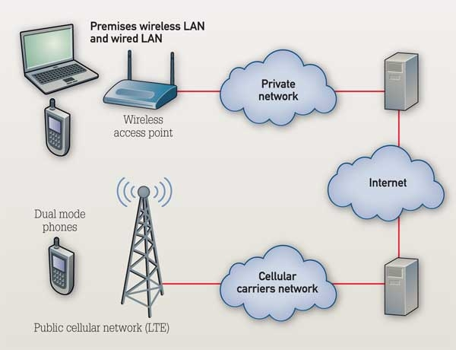
Common ICT Technologies
Internet
  Wired or wireless
Radio communication
Cellular networks
Notes:
Some common technologies that telecommunications use are the internet, radio communication, and mobile phone networks.

Slide 7

The Role of ICT in Society
Changes the world around us
Has implications for our lives and lifestyles now and in the future
It affects every aspect of
our lives
Access to information
brings change
Notes:
We cannot underestimate the amount of change and importance that ICT plays in our world. Access to information brings change, which affects almost all aspects of our lives. Access to information changes each of us personally and transforms our societies. We use this information to make everyday decisions, and we use it to make long-term plans. For example, where do I want to work or where will I study? Think for a moment of the impact if cellular communications were shut off. How would this affect you? Perhaps initially, the impact primarily affects your social life and your access to information. What if the internet was shut off? In August of 2017, Google made an error, and the mistake turned off the internet in Japan for almost 8 hours. The news reports said that it affected East Japan Railway, which prevented its riders from buying tickets or boarding trains. Transportation is critical to our daily lives. Our societies require and depend on the consistent and constant flow of information.
https://www.engadget.com/2017/08/28/google-accidentally-broke-internet-japan/

Slide 8
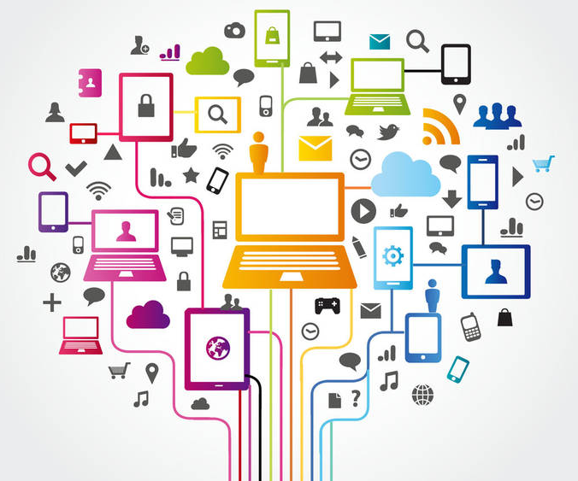
ICT Focuses on Telecommunication
Information
Communication
Technologies
Notes:
The primary focus of ICT is on telecommunication, which is using technology to communicate information at a distance. One form of communication technology is the internet, but the internet is just one avenue or method of transmitting data. ICTs use a wide range of technologies.

Slide 9
Information
Information is meaningful data that leads to knowledge
Knowledge brings
about change
Data
Knowledge
Inform-ation
Notes:
Information is meaningful data that leads to knowledge. The information has a meaning to either the sender or the receiver, or perhaps to both. Once the recipient has the transmitted information and it becomes knowledge, it then affects them in some manner that directs their actions.

Slide 10
Communication
Communication is the sending and receiving of information (or transferring information)
One-to-one (personal) or one-to-many (broadcast)
Technology provides many ways of communicating with others
  The primary methods are through text, voice, or video
Notes:
Communication is the transfer of information. We communicate every day. We might speak something, type something, or we might even make a gesture or use body language unintentionally that sends a message, either positive or negative. We can communicate to a single party one-to-one. Or, we can broadcast our message and communicate one-to-many. Technology provides many ways of communicating. The primary methods are through text, voice, or video.

Slide 11
Synchronous vs. Asynchronous
Synchronous: At the same time
  The devices or people communicating are in sync
  The sender waits for a reply
Asynchronous: At different times
  A message is sent without waiting for a reply
  A reply may or may not come
Notes:
There are two primary methods of communication: Synchronous and Asynchronous. Let's break down the words to help you understand:
A - means negative, or not.
Syn - means equal, or same.
Chronos - means time.
Therefore, synchronous means at the same time. During synchronous communication, someone or a device communicates something and then they are waiting for a response. For example, you are talking to someone on the phone. You are expecting a two-way dialog.
Asynchronous communication happens at the different times. The sender sends a message, but the receiver does not have to reply immediately or even at all. Perhaps the information is an announcement, or it could be a question on WhatsApp that can wait several hours.

Slide 12
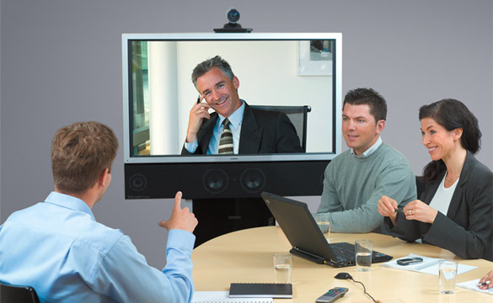
Synchronous Communication
Phone conversation
Instant messaging
Video conferencing
Audio conferences
Notes:
Examples of synchronous ICT communications are phone conversations, instant messaging, video and audio conferencing. In each case, there is a dialog, a two-way conversation, back and forth. These forms of communication might use a variety of media or channels. For example, a typical phone call uses the cellular provider’s network, but a VoIP call (or voice over IP) uses the internet. Alternatively, the VoIP caller could dial a mobile phone.

Slide 13



Asynchronous Communication
SMS, WhatsApp, Telegram
Voicemail, video message
Email
Discussion Forums
Blogs
Wikipedia (knowledge base)
Google (search engine)
Notes:
While synchronous communication expects an immediate response, asynchronous is used for situations where the sender isn’t waiting for a quick response or isn’t waiting for a response at all. An example is sending an email requesting information. Or, you send a WhatsApp message home to your family saying you will be late. These are examples of one-to-one asynchronous communication. Wikipedia and Google are examples of one-to-many asynchronous communication tools. Usually, we are the recipients of the information, not the sender. We can search for and obtain information on Wikipedia that someone added. Similarly, Google is a communication medium that guides us to the information on a blog or news site that someone else added.

Slide 14
Synchronous vs. Asynchronous
 | Synchronous | Asynchronous
One to One | Phone Video conference Instant message Chat room | Email Voice mail
One to Many | Group chat Conference call | Email Discussion group Wiki
Notes:
This chart shows how the different communication technologies can fit into the various quadrants of one-to-many, one to one, and synchronous, and asynchronous. They don't all fit neatly in the box. For example, one can use email, which is asynchronous, as a personal message or to a group of recipients. How do you use WhatsApp? Does the context determine if you need an immediate response or if a delayed response is acceptable?

Slide 15
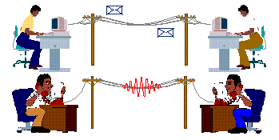
Synchronous vs. Asynchronous
Notes:
Here is another example. Which one is synchronous and which one is asynchronous? If you said the voice call is synchronous, you were correct.

Slide 16
Summary
ICT focuses on communication technologies
Information - meaningful data that leads to knowledge
Communication - the transfer of information
  Synchronous – communicating at the same time
  Asynchronous – communicating at different times
Notes:
In summary, ICT stands for information and communication technology. It focuses on communication technologies. Information is meaningful data that leads to knowledge. Communication is the transfer of information. Two types of communication are synchronous and asynchronous. Synchronous is communicating at the same time. Asynchronous is communicating at different times.

Slide 17

1.2. Technology
1.1. Information and Communication
1.2. Technology
1.3. ICT in Education
1.4 Standards
Notes:
Let’s now move on to the technology portion of ICT.

Slide 18
Learning Objectives
Understand what technology means
Describe the characteristics of a computer
Explain the difference between the internet and the www
Describe the role of telecommunications

Slide 19

Technology
Definition: the application of scientific knowledge for practical purposes, especially in industry.
Communication technology pre-exists electronics
  16th century BC – The Phoenicians developed an alphabet
  105 AD – Tsai Lun invented paper
  751 – Paper is introduced to the
  Muslim world after the Battle of Talas
  1250 – The quill is used for writing
Notes:
One definition of technology is the application of scientific knowledge for practical purposes, especially in industry. Technology does not need to include electronics, but it often does in modern ICT. On the previous slide was a picture of an old manuscript using the form of print-technology that they had available at the time. Before print technology, writers used a writing tool and something to write on, which required someone to develop both of those technologies. The Chinese developed paper in the second century, but they kept the technology a secret for over 600 years. Even after paper was introduced to the Muslim world in 751, the quill pen would not be developed for another 500 years. During that time, there was an earlier form of technology that the early writers used. Technology can also be abstract, such as the alphabet. Before writing in a phonetical format, which is common today, someone had to develop the alphabet.

Slide 20
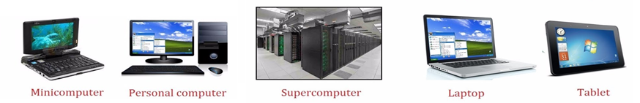
Computers (1 of 2)
Definition: A computer is an electronic device that manipulates information, which is data. It stores, retrieves, and processes the data.
Notes:
Today, ICTs assume the use of electronic devices or using telecommunications. We call these devices computers. A computer is an electronic device that manipulates information, which is data. Computers work with data.

Slide 21
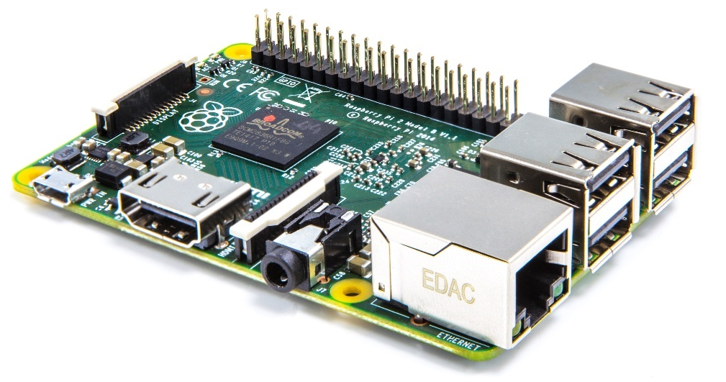
Computers (2 of 2)
Stores data
Retrieves data
Processes data
  Performs a set of instructions
  on the data to generate a specific output
Notes:
The devices must be able to perform the three specific activities of storing, retrieving, and processing the data. Processing data means to manipulate it or evaluate it that results in a specific output, which a computer does through a series of steps that is a called a process.

Slide 22
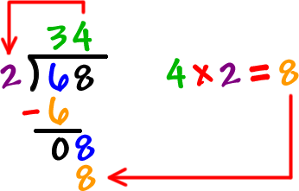
Processes (1 of 3)
Definition: A process is a series of actions or steps taken to achieve a particular result
Notes:
A process is a series of actions or steps taken to achieve a particular result. Do you recall learning the process of doing long division? Cooking or making tea are examples of processes. Before we can enjoy our flavored hot drink, we need to perform actions. Otherwise, we end up with a cup of water.

Slide 23
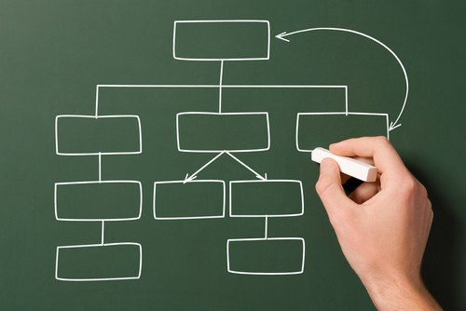
Processes (2 of 3)
Computers use programs to process data
Programs are a specific set of instructions
Notes:
Computers use programs to process data. Programs perform a specific set of instructions that manipulate the data to achieve some result or action.

Slide 24
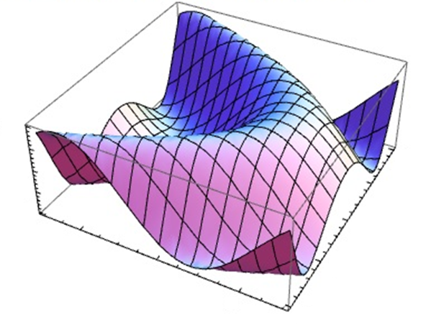
Processes (3 of 3)
Examples of computer processes or operations:
  Performing calculations
  Logical decision making
  Outputting data
  Manipulating data
  Communicating with others computer
Notes:
Computers use programs to process data. Programs perform a specific set of instructions that manipulate the data to achieve some result or action. Some examples are:
Performing calculations,
Logical decision making: for example, should the music application play the next song or stop
Outputting data: such as, show me my WhatsApp messages
Manipulating data: an example is Google Translate changing Russian to English, and
Communicating with others computers

Slide 25
Characteristics of Computers
Speed
Mathematical and logical operations
Accuracy
Reliability (consistent)
Storage
Retrieving data and programs
Automation
Versatility (Flexible)
Consistency
Communications
Notes:
https://officialamitjha.blogspot.com/2017/07/characteristics-of-computer.html
Computers come in various shapes, sizes, and configurations designed to accomplish their specific tasks. But, all computers have these characteristics in common:
Computers operate at a certain speed, usually measured in MHz or GHz. Faster speed means more processing power. Our smartphones vary the speed of the processor to save power.
They perform mathematical or logical operations and do so accurately and reliably. Accuracy means the mathematical calculation is correct. Reliably can refer to the physical device operating without failure and it can repeatedly perform the action correctly.
Computers store, retrieve, then process the data using a set of instructions.
They work automatically to perform a series of actions without specific human input or interaction.
Computers are versatile, meaning they can perform different types of tasks or jobs.
Computers consistently perform the same action again, again, and again.
They relay or exchange information through some medium.

Slide 26
Applications of Computers
Science research
Education
Business applications
Banking
Office automation
Desktop publishing
Management support
Engineering designing
Road traffic control
Railway
Medicine
Information services
Notes:
There is no end to the application of computers. Probably without exception, every sector and every part of society use a computer in some form or fashion. Even a sheepherder on the steppe will have a mobile phone.

Slide 27
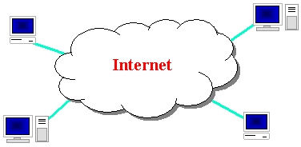
The Internet
Definition: The internet is a global computer network providing a variety of information and communication facilities, consisting of interconnected networks using standardized communication protocols.
A "network of networks" that consists of millions of networks that connect our world
A globally connected network
through LANs or WANs

Slide 28
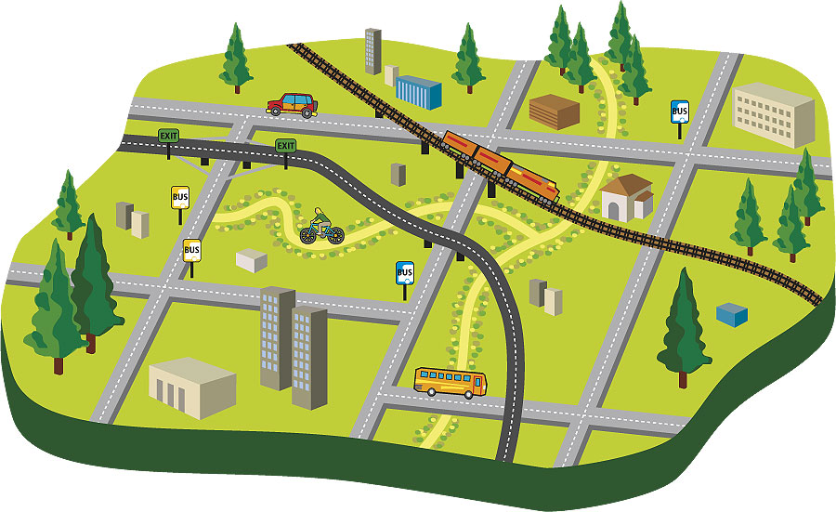
The Internet
Provides the transportation of the network services
using protocols
Similar concept of
the transportation
infrastructure
Notes:
The internet is like the transportation infrastructure. There are roads, highways, interstates, train track, and waterways that carry various vehicles and different cargo. Similarly, the internet provides these pathways for the vehicles that carry the data for the different network services.

Slide 29
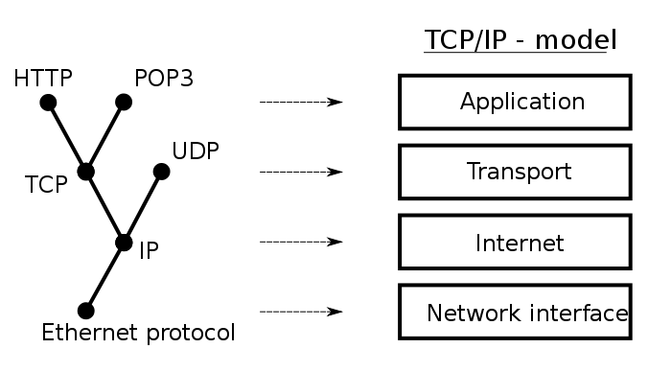
Internet Protocol Examples
The world wide web
  web data through HTTP
Communication
  Email, VoIP, IM
Data transfer
  FTP, streaming media, webcams, peer-to-peer
Notes:
One network service is the world wide web, which is accessing web data using HTTP as you usually do through your web browser. HTTP uses the TCP/IP protocol. Another service is communication, such as email and voice over IP. Examples of these protocols are POP3 or UDP. Data transfer is another service. If you download a file from a website, you are likely using the world wide web. But you will use a data transfer service if you stream a video through YouTube, use torrents, or FTP.

Slide 30


Brief History of the Internet
Began as a US Department of Defense network called ARPANET (1960s-70s)
Initial services: electronic mail, file transfer
Opened to commercial interests in the late 80s
Tim Berners-Lee creates the www in 1989-91
Popular web browsers released:
  Netscape 1994, IE 1995
Amazon.com started in 1995; Google January 1996
Notes:
https://www.vox.com/a/internet-maps
The internet started as a US Department of Defense project with the initial services of electronic mail and file transfer. ARPANET was then opened to the commercial interests in the late 80s. Sir Tim Berners-Lee, a British computer scientist, created the world wide web shortly after that. For the web to be useful, that is for someone to find something on it, developers then created web browsers, such as Netscape and Internet Explorer. The dot-com boom happened in the mid-90s with notable companies such as Amazon.com and Google opening.

Slide 31
Uses of Internet
Searching
E-mail service
Commercial services
Electronic books and publication
Video conferencing
Sharing data and results quickly
Retrieving files and applications
Find information tutorials
Newspaper columns
Banking
Downloading/uploading any information
News, sports, stocks, music, etc.
Various fields use the internet, such as education, business, government, etc.
Many more uses…
Notes:
The internet provides the communication channels that any number of services can use. This list includes a few, such as searching for information, banking, news, or sharing information. The internet is vital in today’s world.

Slide 32

The World Wide Web
The world wide web (abbreviated www or the web) is a collection of interconnected documents and other resources, linked by hyperlinks and URLs
The www is accessible
via the internet
Notes:
The world wide web is one of the many services that use the internet. The web is a collection of interconnected documents and other resources, linked by hyperlinks and URLs. You use the world wide web anytime you go a public website to retrieve data using HTTP or HTTPS, such as bbc.co.uk. The world wide web is dependent on other services, such as DNS. DNS converts the domain name, such as google.com, to the actual IP address. Computers work in numbers, but humans work in symbols or letters.

Slide 33
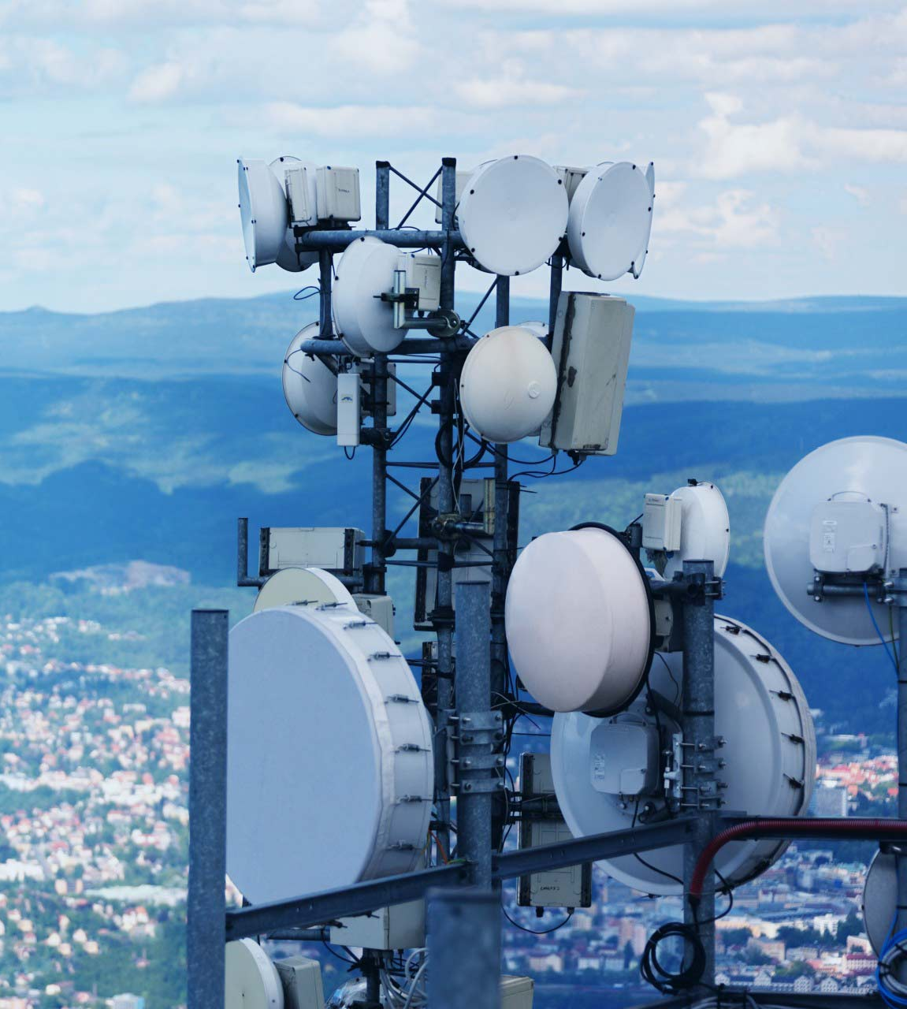
Telecommunication (1 of 2)
Definition: is the exchange of information over significant distances by electronic means. It refers to all types of voice, data, and video transmission
Tele: at a distance
Notes:
Telecommunication is the exchange of information over significant distances by electronic means. It refers to all types of voice, data, and video transmission. The prefix tele means at a distance, so communicating at a distance. Telecoms, short for telecommunications, is a branch of technology that works with telecommunication.

Slide 34
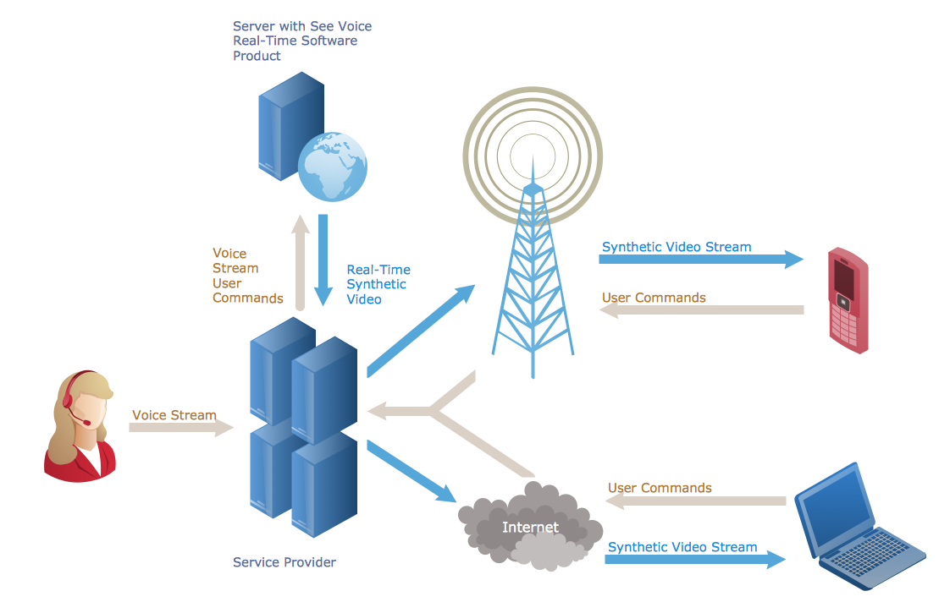
Telecommunication (2 of 2)
Transmits data by wire, radio, optical, or other electromagnetic systems
May or may not use the
internet to transmit
the data
Notes:
Telecoms transmit via data wire, radio, optical, or other electromagnetic systems. They can use the internet to transmit data, but they often have their own method. For example, cellular phones use cell towers to communicate. However, you can connect your phone to a WiFi network and use the internet to make VoIP call or send a WhatsApp message.

Slide 35
Evolution of ICT Tools
Radio, television, video, DVD, telephone (fixed line & mobile), satellite systems, computers, network hardware, and software
Chalk and
blackboard,
Landline
Overhead
paging
system,
Pager
TV/VHS,
Wireless
Phone
LCD, PC
Whiteboard,
Interactive
Panel
Instant
messaging,
Web 2.0
applications,
Mobile apps
(cellular and
internet
based)
Notes:
ICT tools have evolved and changed over the years. As we said earlier, technology is the application of scientific knowledge and does not have to be something electronic. For example, pen and paper are significant advances in technology that allowed someone to save written work. The digital evolution includes radio, television, video, DVD, telephone, both fixed line & mobile, satellite systems, computers, network hardware, and software. Other examples of ICT advancements are from chalk and blackboards to interactive panels, which are larger versions of tablets.

Slide 36
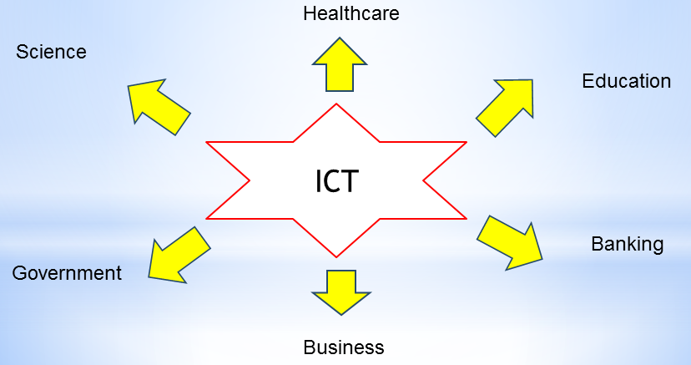
The Internet as an ICT Tool
Education
Research
Communication
Exploring the world
Leisure and Entertainment
And many more …
Notes:
While ICTs use other communication media, there is no end of using the internet as an ICT tool. Many industries use the internet to communicate or exchange information. The education sector is increasingly using the internet, which includes instructional videos, such as this one, learning management systems, or administrative tools to post grades online. Research often requires sharing information, which uses the internet and web. The internet opens up many different possible ways to communicate with others. Examples are VoIP, sharing media, email, blogs, social networking sites, and discussion groups. The internet has many services that help someone explore the world, such as travel sites that showcase destination or mapping software that directs someone to their location. There are many entertainment options via the internet, which include streaming music, videos, or playing online games.
Education
There is much education that happens online, outside of the classroom.
Instructional videos, such as this one, virtual learning environment, or administrative tools to post grades online
Research
Research often requires sharing information, which uses the internet
Communication
The internet opens up many different possible ways to communicate with others. Here are some:
Email
Blogs
Social networking sites, e.g., Facebook,
Chatrooms or discussion groups
Forums
VoIP - internet telephone
Leisure and Entertainment
There are many different ways that you can choose to spend your time online and amuse yourself. Here are a few:
Playing online games
Listening to music (mp3 download or live streaming)
Reading online books and e-books
Watching online videos, e.g., YouTube
Looking for holidays or concert tickets
Reading about your hobbies
Keeping up-to-date with the news and sporting events
Watching 'catch up' television from the main channels
Exploring the world
The internet has many services that help you explore the world.
Satellite and mapping applications, e.g., Google Earth
Travel sites providing details of other places
Live web cams showing other parts of the world
Almanacs and encyclopedias

Slide 37
Summary
Technology is the application of scientific knowledge
Computers store, retrieve, and process data
The internet is the global computer network
The www is a collection of interconnected documents and other resources
Telecommunications uses electronic device to exchange information over significant distances
Notes:
In summary, technology is the application of scientific knowledge. A computer is an electronic form of technology that stores, retrieves, and processes data. Other characteristics of a computer are performing mathematical or logical operations accurately and reliably. The internet is the global computer network that provides the communication channels. The world wide web is just one of the services that use the internet. The www is a collection of interconnected documents and other resources that are accessible through a web browser. Lastly, we discussed telecommunications to exchange information over significant distances by electronic means. The telecommunication device may or may not use the internet.

Slide 38
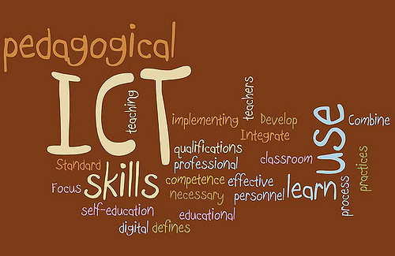
1.3. ICT in Education
1.1. Information and Communication
1.2. Technology
1.3. ICT in Education
1.4 Standards
Notes:
This section talks about ICT in Education, which is one of the numerous sectors of our society.

Slide 39
Learning Objectives
Describe what roles ICT plays in the sector of education
Explain ways that ICT technologies increase learning opportunities
Explain ways that ICT technologies provide greater access to learning material
Describe the role of an LMS
Notes:
The primary goal of the series is to understand how ICT functions so you can see what role it plays in today’s society.

Slide 40
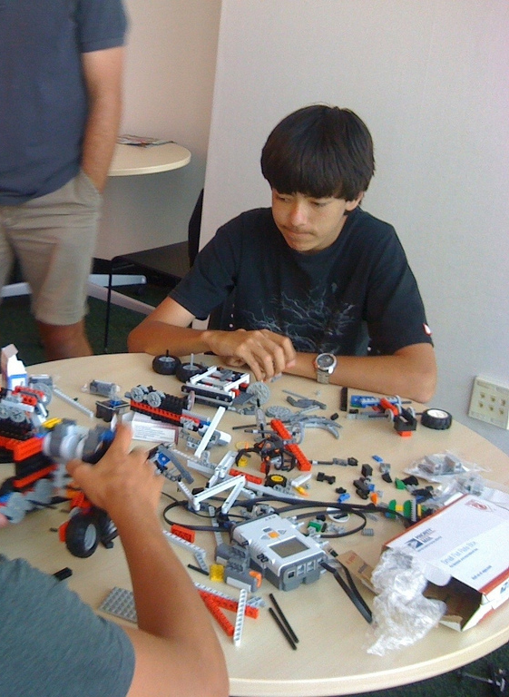
Why use ICTs in Education
From an Ancient Chinese Proverb:
I hear and I forget,
I see and I know,
I do and I understand.
Notes:
According to one study, researchers ran a test to measure how much of a presentation that the audience remembered. They found that immediately after a 10-minute presentation, listeners only remembered 50% of what was said. By the next day that number had dropped to 25%, and a week later it was only 10%. An ancient Chinese proverb says: I hear and I forgot, I see and I know, I do and I understand. ICT in education helps educators extend the classroom beyond hearing, so you see and know, and then do and understand.

Slide 41
The use of ICT in Education
Expands learning opportunity
  distance learning, elearning, blended learning
Access to educational content
  Online learning environments, digital content, multimedia
Facilitates additional teaching and learning methods
  learner-centered, self-directed learning, tailored learning
Administrative tools
  education management information systems (EMIS)
Notes:
Like many industries, ICT plays a crucial role in today’s education. Educational ICT primarily uses the internet.
ICT expands learning opportunities, such as elearning or blended learning
ICT allows access to educational content online
ICT allows educators to use different learning methods, beyond lecturing in a classroom. Educators can produce videos, such as this one, to help those who have a difficult time understanding the lecture, or maybe they were gone
ICT also helps the administrators manage their data, such as the student grades and which classes they’ve taken

Slide 42
Traditional vs. Internet-based ICT education Approach
 | Traditional Classroom | ICT in Education
Classroom | Physical – limited space Synchronous Lectures, limited options for interaction | Unlimited opportunities Anytime, anywhere Interactive, synchronous, asynchronous
Content | PowerPoint, projector, whiteboard Textbooks, library | Multimedia, simulation Digital library On demand
Personalization | Instructor determines the same learning path for all students | Learner controls their own path
Notes:
There are some notable differences how using ICTs in education creates change. In the traditional classroom, there is limed space, we have to meet at the same time, and there are limited options except giving the information through a lecture. However, using ICTs changes almost all aspects. For example, students can now learn anytime, anywhere through asynchronous methods that are still interactive. The content changes from PowerPoints and using textbooks to multimedia and online resources that substitute for textbooks. In a traditional environment, there isn’t much that an instructor can do to accommodate the students. However, ICTs allow students to control their path and choose how and when they want to learn.

Slide 43

ICTs can Help Teachers Teach
Supports traditional learning
  Developing innovative and interactive lessons
  Selecting various content delivery methods
  Using classroom time differently instead of lecturing
Enhances collaboration
efforts with other teachers
when developing lessons
Notes:
ICTs help both the teacher and students. They help the teacher to support traditional learning through changing how education happens. For example, the instructor can do more showing and demonstrating in class instead of giving information. That is the exact point of this video. Instead of listening to your instructor in class give you this information, your instructor could show you how things work since you already have the knowledge about the topic.

Slide 44

ICTs can Help Students Learn
Encourages independent active learning
  Access to vast online resources
Enhance inquiry and
exploratory skill
  Search for and compare
  information from different
  sources
Notes:
ICTs help students learn. Through the web, they have access to vast online resources to help them understand the topic. When they search for this information, they are developing skills that help them to direct their own learning.

Slide 45

ICTs can Help Students Learn
Improved communication
  Student-to-student for collaboration or learning
  Student-to-instructor for assistance
Develop writing skills
Various ways of presenting projects
  Multimedia, online presentation tools
Notes:
ICTs also provide options for communication so the students can collaborate and work on a project at a distance or at different times. They can also easily send their instructor a message asking for assistance. The students develop their writing skills when they engage in online discussion or type a writeup about a project. Multimedia provides them with additional opportunities to present projects using the many online tools

Slide 46

Learning Management Systems
Organize class resources
Centralized information and learning
Easy to expand elearning course or materials
Access to class resources anytime
Track progress or
view grades
Notes:
Learning management systems, abbreviated as LMS, also called virtual learning environments, become an online classroom. Educators can organize the class resources so the students have a centralized location for information and learning. The instructor can easily add additional materials to help the students. The students can access the class resources anytime, and they can track their progress and view grades. An LMS replaces the classroom as the central component. The classroom becomes one the parts of the class.

Slide 47
Summary
Increase learning opportunities and provide greater access to learning material
Teachers use ICT to support traditional learning
ICTs help students by improving communication, collaborative learning, and independent learning
LMSs centralizes the online learning process and resources
Notes:
Learning management systems, abbreviated as LMS, also called virtual learning environments, become an online classroom. Educators can organize the class resources so the students have a centralized location for information and learning. The instructor can easily add additional materials to help the students. The students can access the class resources anytime, and they can track their progress and view grades. An LMS replaces the classroom as the central component. The classroom becomes one the parts of the class.

Slide 48

1.4. Standards
1.1. Information and Communication
1.2. Technology
1.3. ICT in Education
1.4 Standards
Notes:
Standards are an essential part of ICT. Standards ensure that ICT technologies work together. Telephone calls have regulations that guarantee that if a phone call is placed in one country, someone in another country can answer the call. Or, they give assurance that your phone will work with a telecom company in a different country.

Slide 49
Learning Objectives
Describe why standards are important
Explain a consequence of not having standards

Slide 50
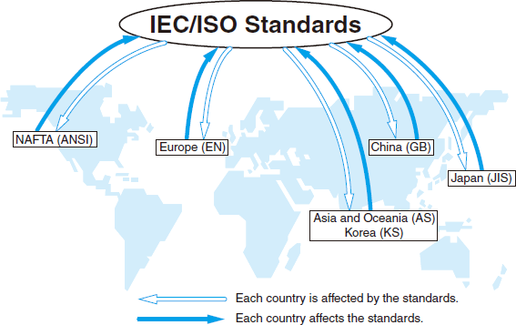
The Global ICT Standards
An international group of organizations and businesses produce the global ICT standards
  dictates how the ICT industry
  should function
  are developed in many
  venues and countries
Notes:
No one company or country governs the ICT industry. Instead, there is an international group of organizations and businesses who produce the global ICT standards, which dictates how the ICT industry should function. Each country is responsible for their industries, but if they want their telecommunication equipment to communicate globally, they need to know which standards to meet.

Slide 51
The Global ICT Standards
The global ICT standards group share certain characteristics
  They respond broadly to the needs of global markets
  They demonstrate relevance through voluntary worldwide adoption and implementation
  They are products of standardization processes that are consensus-based, transparent, and industry-led with participation open to any interested party.
Notes:
The standards are created through collaborative efforts that have a global reach, which is voluntarily and widely adopted by the marketplace across international borders. This group who decides the global ICT standards are responsible to the global markets and make changes when needed. Since adoption is voluntary, the standards group demonstrates relevance and show why it is important to adopt the new standards. The group does not tell the industries what to do, rather, the ICT industries inform them which areas need standardization. They then decide if and how to make a technology a standard.

Slide 52



The Internet: People and organizations
Internet Engineering Task Force (IETF)
  Internet protocol standards
Internet Corporation for Assigned Names and Numbers (ICANN)
  Decides top-level domain names (TLD)
World Wide Web Consortium (W3C)
  Web standards
Notes:
These are some of the organizations who set the standards for the internet. These standards ensure that the internet works the same, no matter where the subnetworks are. For example, the HTTP standards dictate that all web data through the web should use the HTTP protocol. Additionally, not anyone can create a new top-level domain name (TLD) since they are restricted and regulated by ICANN. TLD names are the highest level of the domain name system on the internet. Examples are .com, .net, .ru, and .cn. W3C sets the web standards, so web developers know how to design their websites that correctly work with the various web browsers.

Slide 53
Top-level Domain Names (TLD)
Generic TLDs
.com – Commercial organization
.net – Large Networks
.biz – Online business
.gov – Government organization
.org – non-profit organization
.edu - educational organization
.info – Informational websites
.io – Technical sites
Country or Location Specific
.au – Australia
.cn – China
.de – Germany
.kz – Kazakhstan
.in – India
.ru - Russia
.us – United States
.uk – United Kingdom
Notes:
There are various types of top-level domain names. Some are generic, such as .com, .org, or .me. Others are location specific. For example, only a resident of the European Union can register a .eu domain name, such as freds-cooking-show.eu.

Slide 54

Global Standards Collaboration (GSC)
GSC is an unincorporated voluntary organization dedicated to enhancing global cooperation and collaboration regarding communications standards
and the related standards
development environment.
Notes:
Another standards body is the Global Standards Collaboration (GSC). They are a voluntary group committed to working on communications standards. They also work on enhancing global cooperation and collaboration among developers. The system will become fragmented if every group or country wants to make their technology the standard.

Slide 55
GSC includes the following standards organizations:
Company | Location
Association of Radio Industries and Businesses | Japan
Alliance for Telecommunications Industry Solutions | USA
Communications Alliance Ltd | Australia
China Communications Standards Association | China
European Telecommunications Standards Institute | Europe
International Electrotechnical Commission | International
Institute of Electrical and Electronics Engineers | International
International Organization for Standardization | International
ICT Standards Advisory Council of Canada | Canada
International Telecommunication Union | International
Telecommunications Industry Association | USA
Telecommunications Standards Development Society of India | India
Telecommunications Technology Association | Korea
Telecommunication Technology Committee | Japan
Notes:
Here is a list of the members of the GSC. The important thing to note is the various countries who are involved, which indicates that the GSC is genuinely an international governing body.

Slide 56
Summary
Standards ensure that the technologies will work together
An international group decides the global ICT standards
Technology makers voluntarily adopt the standard
ICAAN is on standards organization that govern the TLDs
Notes:
In summary, standards are an essential part of ICT since they ensure that the technologies will work together. No one country or group governs the ICT standards. Instead, an international group decides the global ICT standards. This group works with the global markets to show why technology makers or developers should voluntarily adopt the standard. We looked at one standards organization, the ICAAN, which governs the creation of top-level domain names. Examples of TLDs are are .com, .net, .ru, and .cn.

Slide 57
Major Sources
http://mpforest.gov.in/HRD/trainingmodule/ICT/ICTConcepts.ppt
http://www.gracekennedy.com/images/lecture/GraceLecture2007.pdf
https://www.gcflearnfree.org/computerbasics/what-is-a-computer/1/
https://en.wikipedia.org/wiki/Information_and_communications_technology
https://techterms.com/definition/ict

